Slide 1
Update on the project: (Determining the dimensions of Sensor)
Aim:
To Observe the sensitivity of Graphite on paper sensor of various lengths and determine the dimensions of the sensor for our utility.
Required materials:
HB pencil
A4 sheet paper
Arduino Uno
Resistor (560k ohms or above 1M ohms)
Multimeter
Procedure:
Draw a rectangle with pencil of dimensions of 5cm*1cm,5cm*0.5cm,5cm*0.3cm as shown in figure1.1.
Give connections as shown in figure 1.2 for the Arduino Uno.
Take the readings of resistance of the sensor using the Arduino code. Convert the readings to graphs using excel.
Tabulate the resistance values of the various length and capture the graphs .
According to the graphs determine the suitable length for sensor.

Slide 2
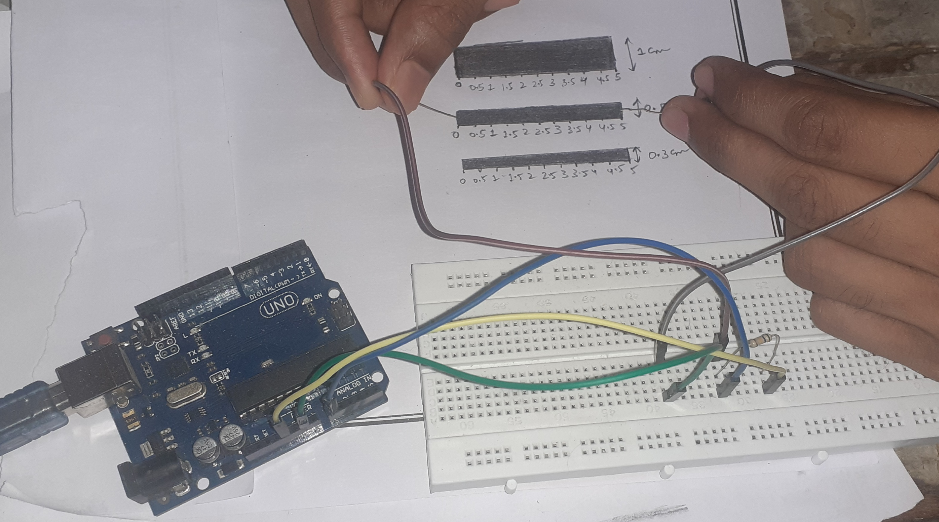
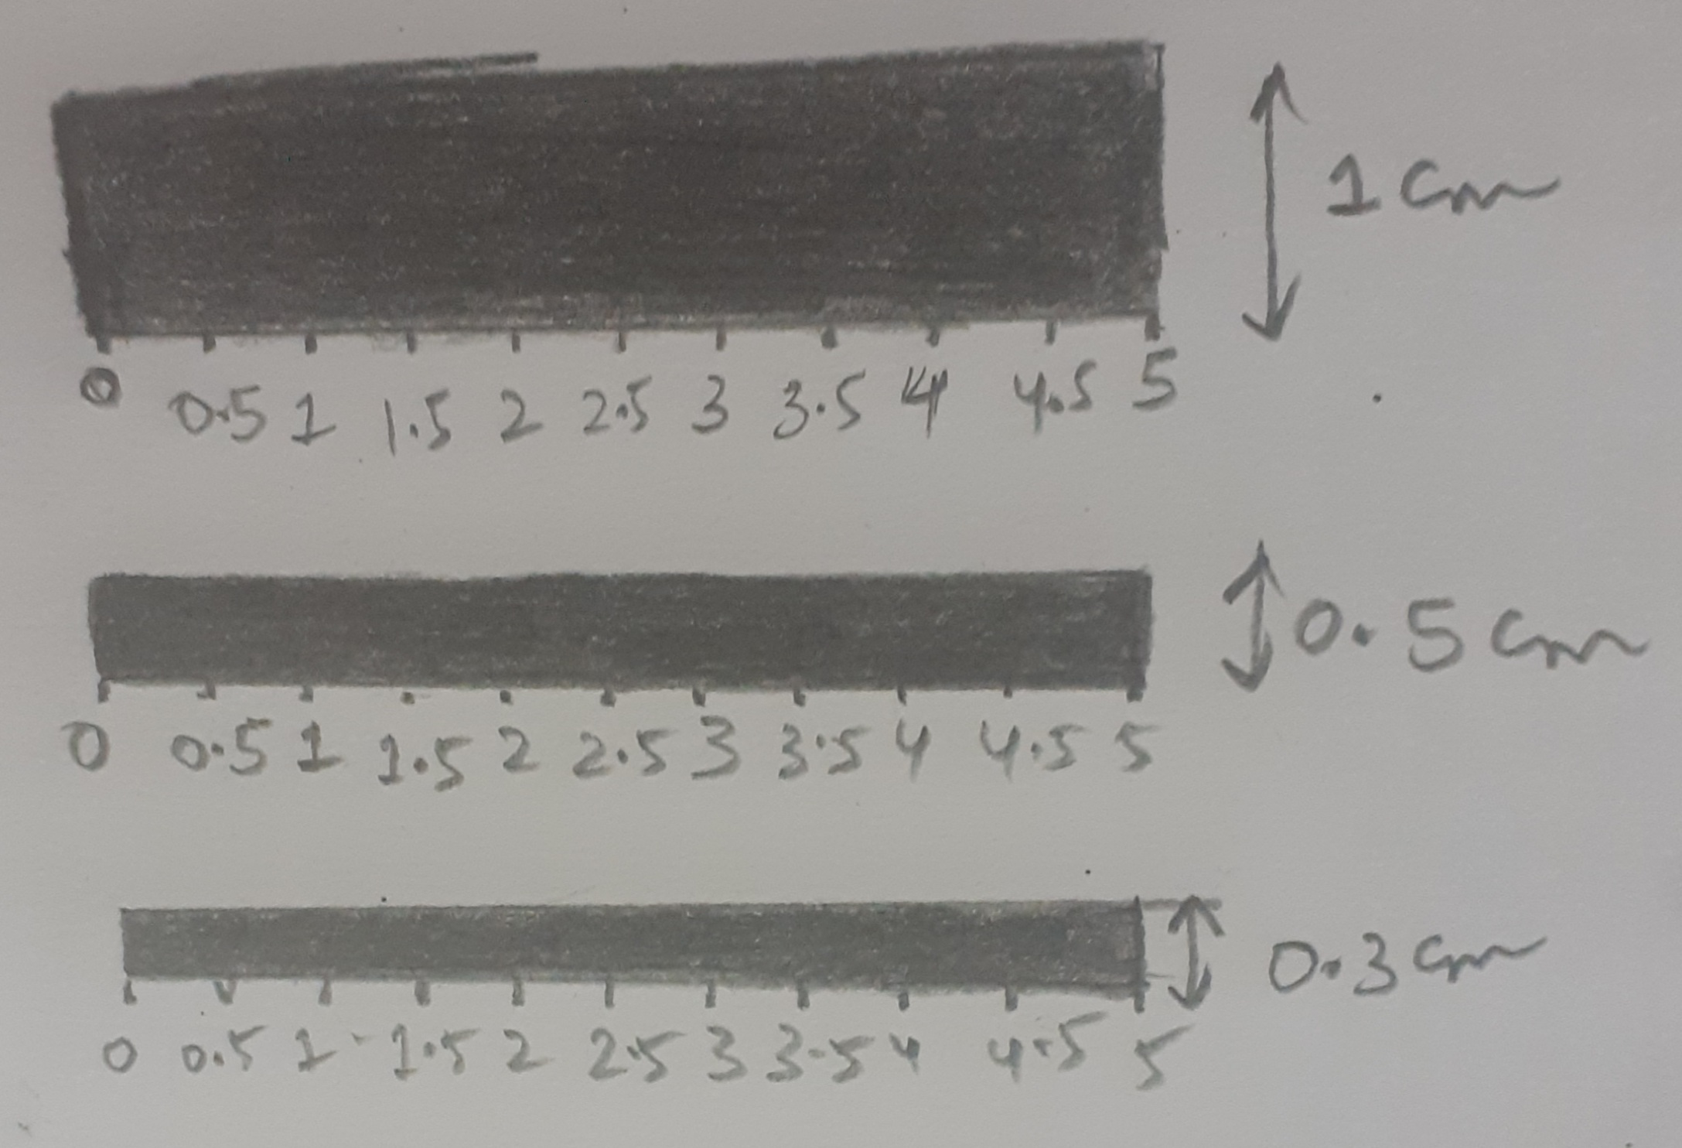
Figure 1.1
Figure 1.2

Slide 3
Arduino code to observe the resistance of sensor
const int sensorPin = A0; // Analog input pin that senses Vout
int sensorValue = 0; // sensorPin default value
float Vin = 5; // Input voltage
float Vout = 0; // Vout default value
float Rref = 560000; // Reference resistor's value in ohms (you can give this value in kiloohms or megaohms - the resistance of the tested resistor will be given in the same units)
float R = 0;
void setup ()
{
Serial.begin(9600); // Initialize serial communications at 9600 bps
}
void loop ()
{
sensorValue = analogRead(sensorPin); // Read Vout on analog input pin A0 (Arduino can sense from 0-1023, 1023 is 5V)
Vout = (Vin * sensorValue) / 1023; // Convert Vout to volts
R = Rref * (1 / ((Vin / Vout) - 1)); // Formula to calculate tested resistor's value
Serial.print("R: ");
Serial.println(R);
//Serial.print("Vout: ");
//Serial.println(Vout);// Give calculated resistance in Serial Monitor
delay(1000); // Delay in milliseconds between readings
}

Slide 4
Readings from Arduino Uno
Resistance values are the product of row*column(ohms) | 1cm | 0.5cm | 0.3cm
5cm | 200k-215k | 300k-314k | 250k-1400k
4.5cm | 250k-265k | 299k-320k | 200k-250k
4cm | 227k-242k | 281k-300k | 240k-180k
3.5cm | 285k-315k | 239k-250k | 208k-200k
3cm | 255k-275k | 150k-165k | 245k-255k
2.5cm | 240k-280k | 134k-140k | 156k-160k
2cm | 450k-500k | 140k-160k | 114k-120k
1.5cm | 265k-287k | 100k-120k | 85k-89k
1cm | 255k-275k | 80k-92k | 62k-66k
0.5cm | 180k-200k | 62k-71k | 35k-40k

Slide 5
Multimeter Readings
Resistance | 1cm | 0.5cm | 0.3cm
5cm | 140k | 144k | 260k
4.5cm | 99k | 106k | 222k
4cm | 82k | 98k | 204k
3.5cm | 75k | 86k | 190k
3cm | 72k | 80k | 177k
2.5cm | 120k | 72k | 150k
2cm | 62k | 55k | 135k
1.5cm | 46k | 34k | 107k
1cm | 55k | 26k | 68k
0.5cm | 40k | 20k | 43k

Slide 6
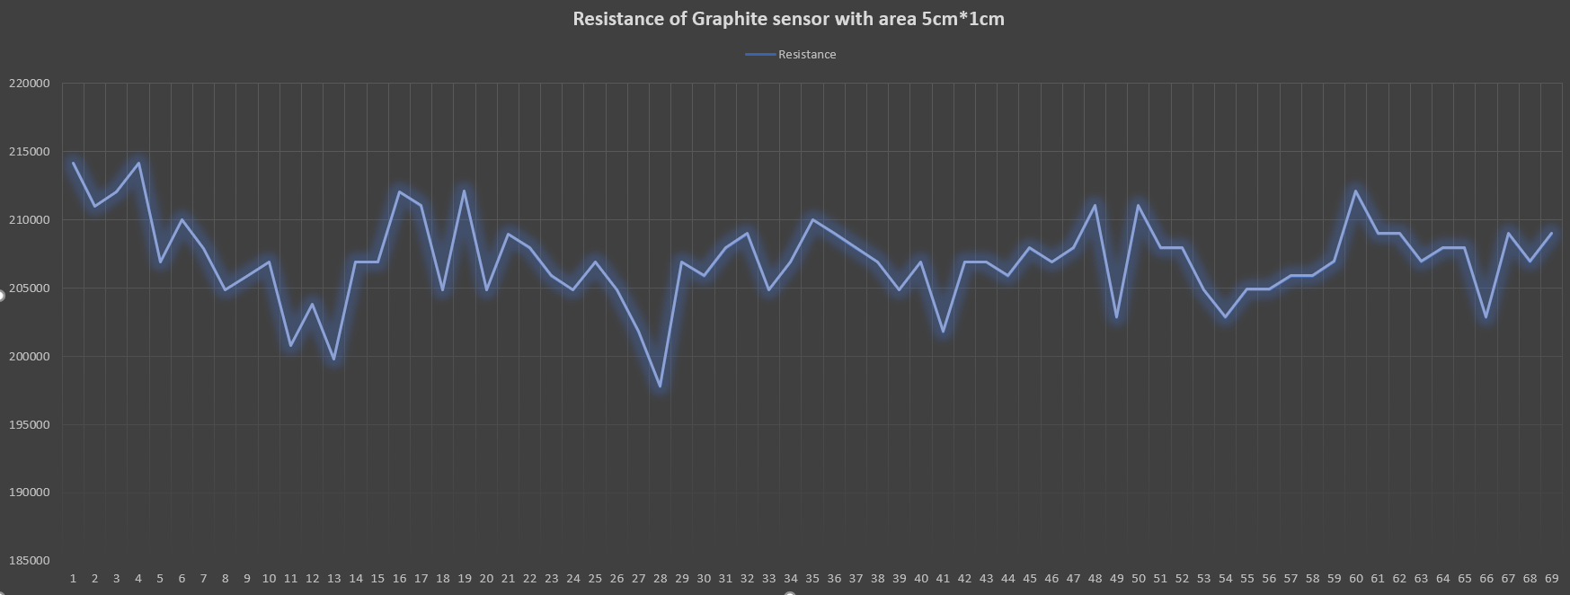
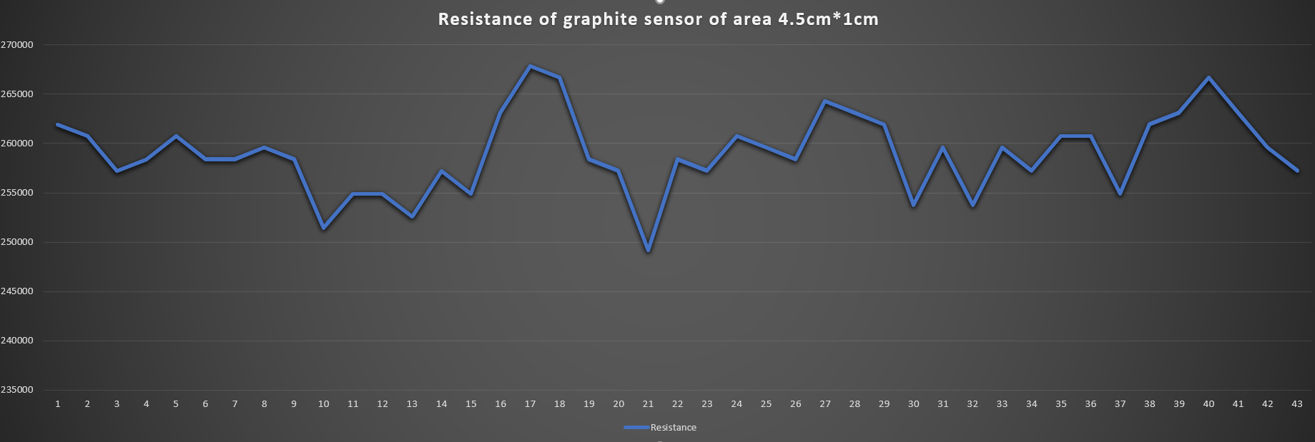

Slide 7
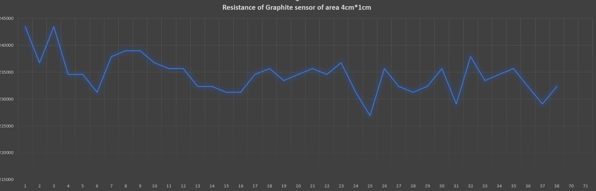
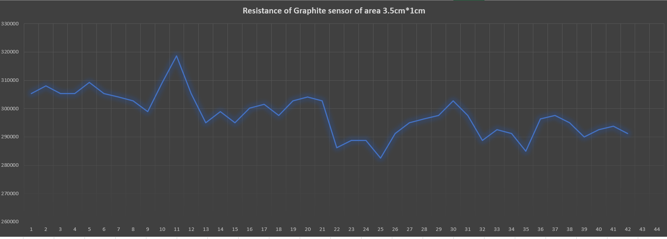

Slide 8
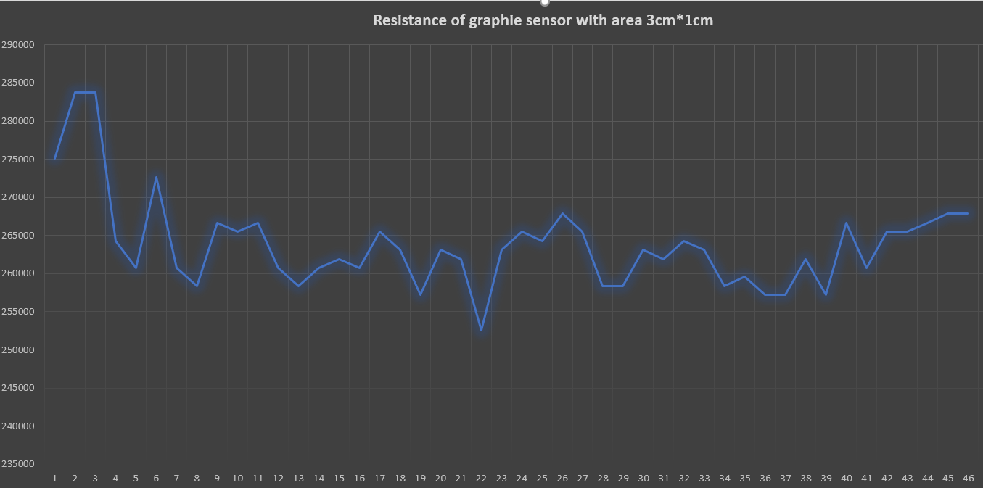
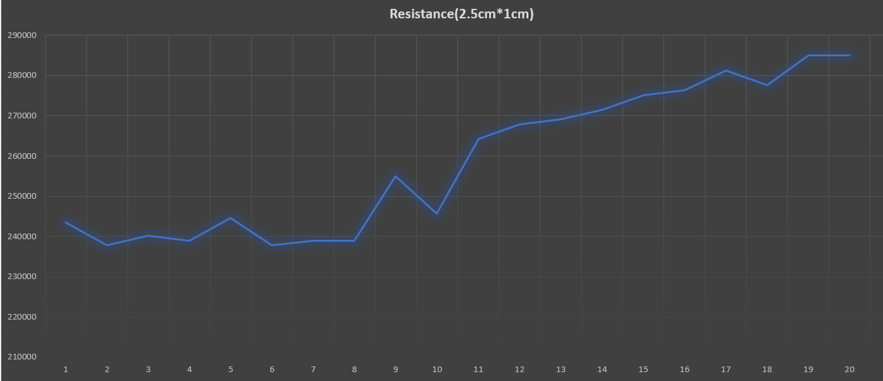

Slide 9
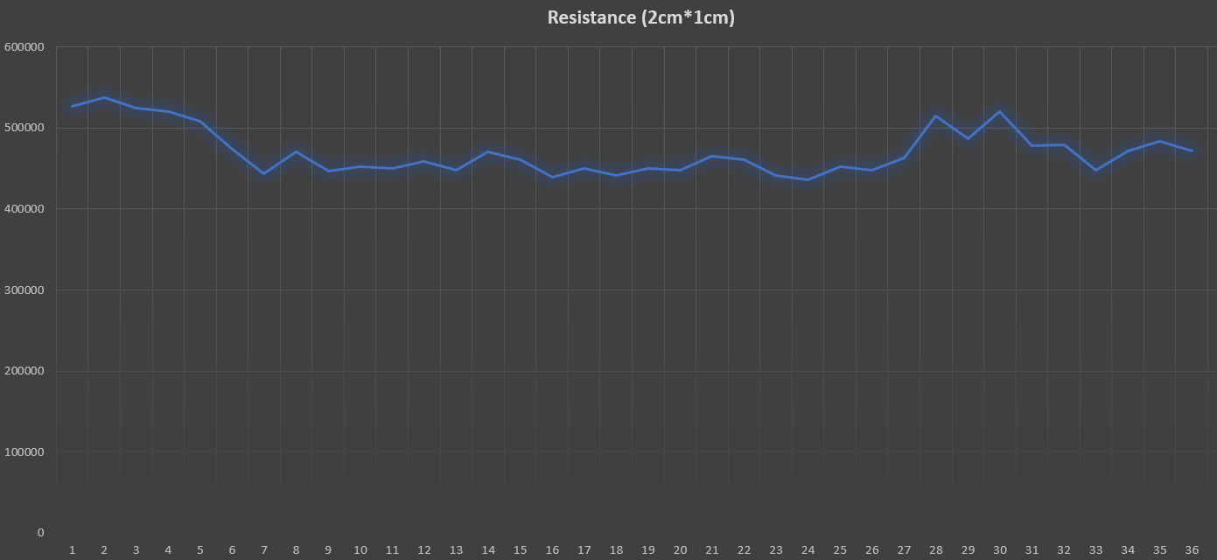
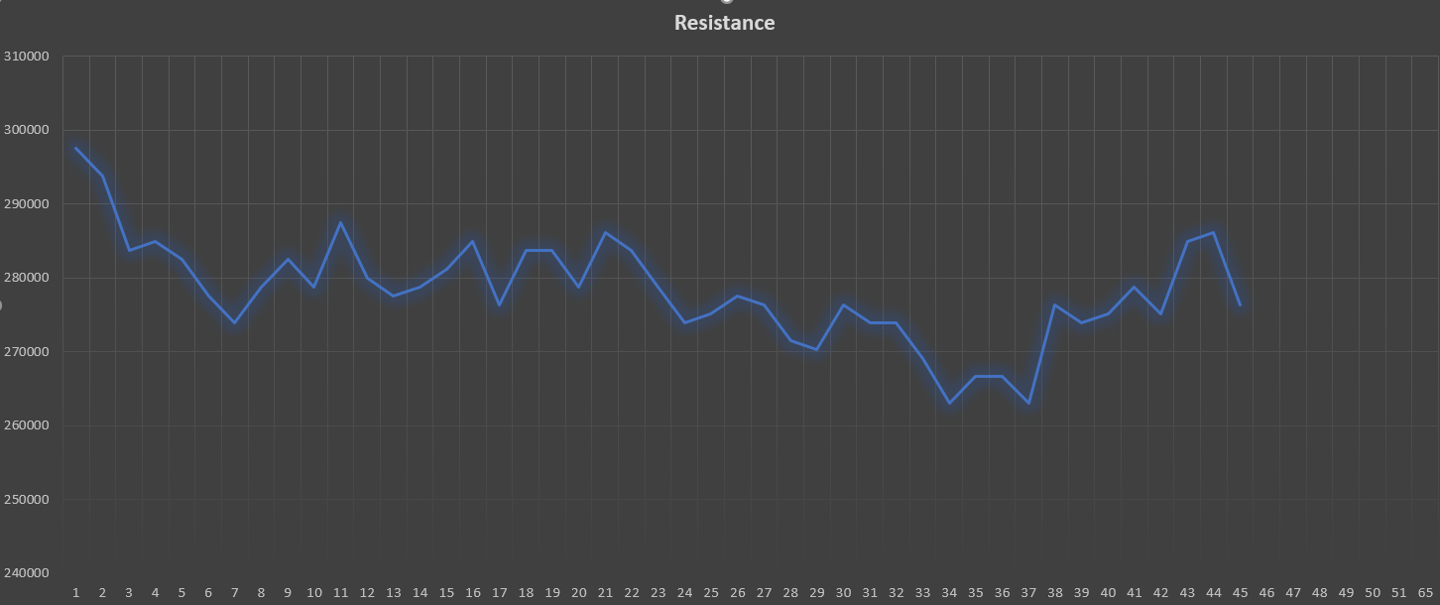

Slide 10
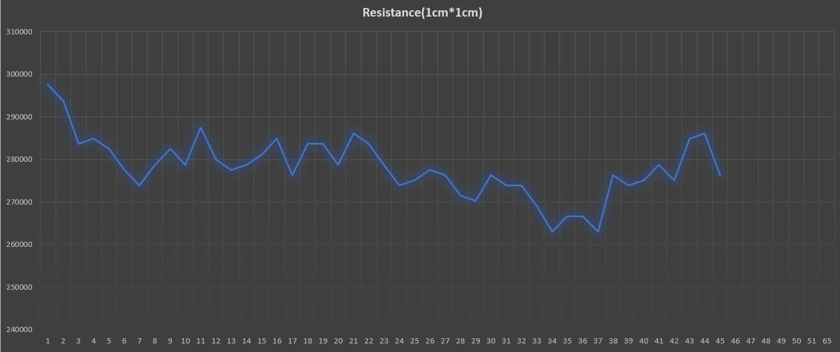
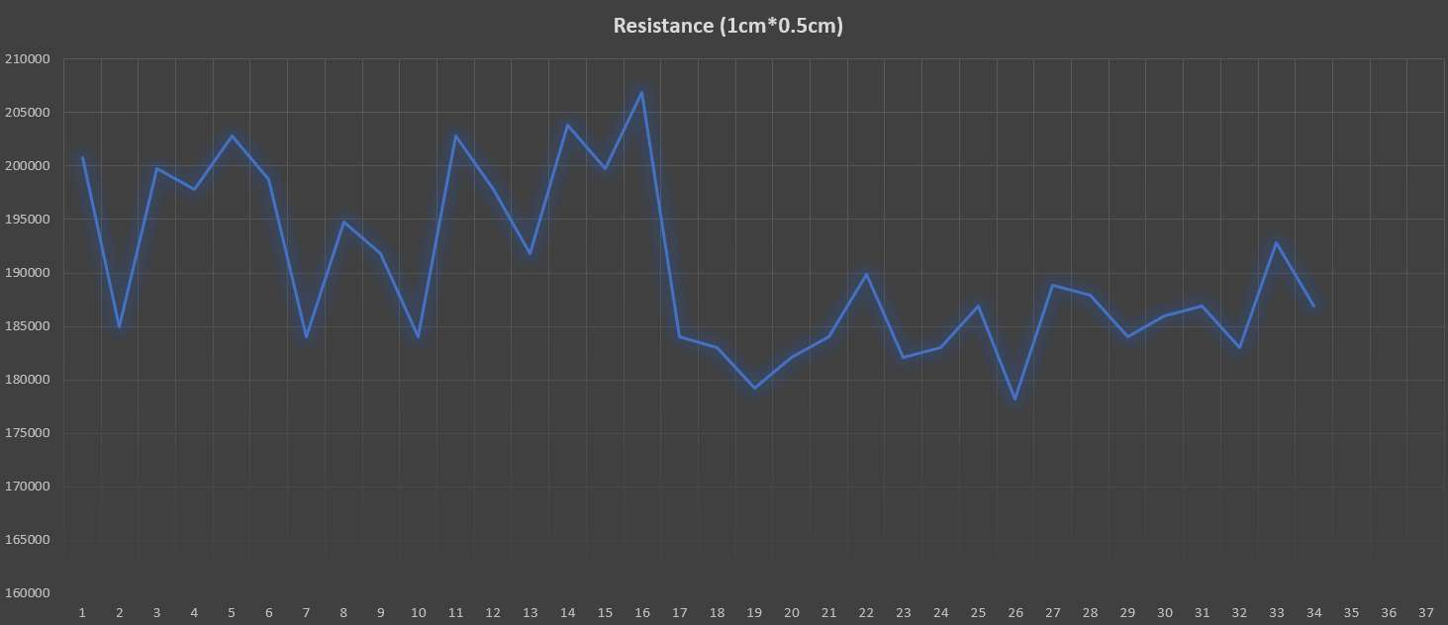

Slide 11
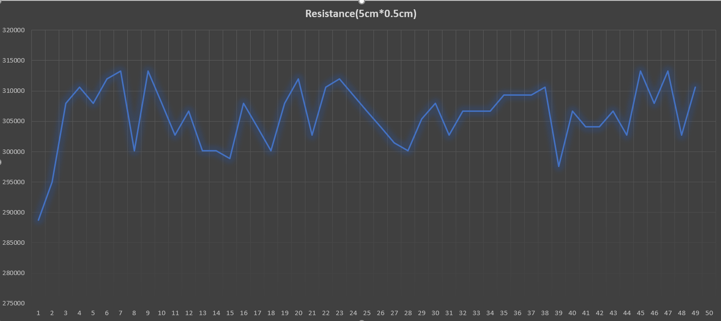
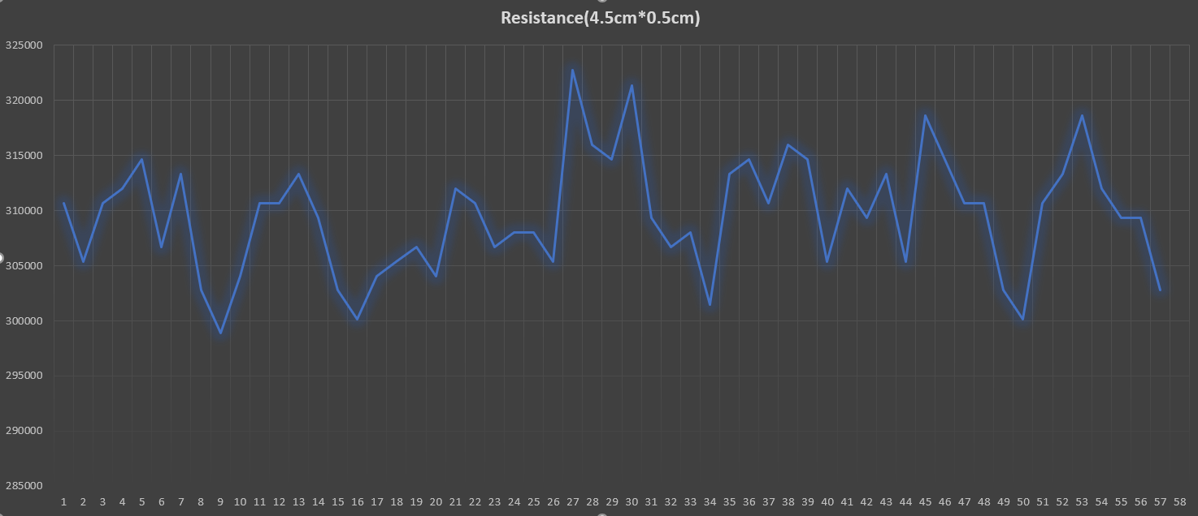

Slide 12
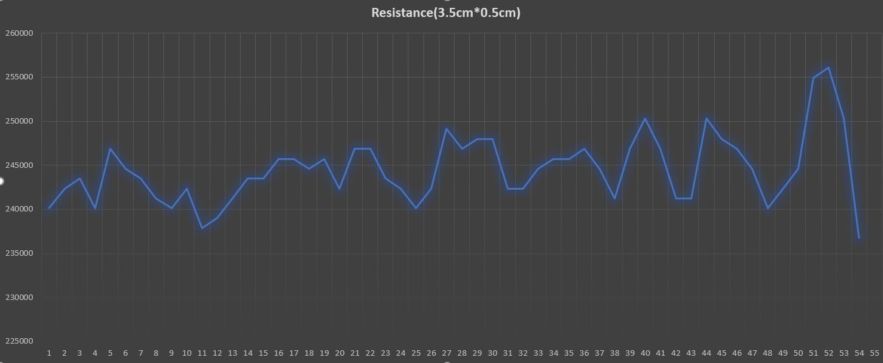
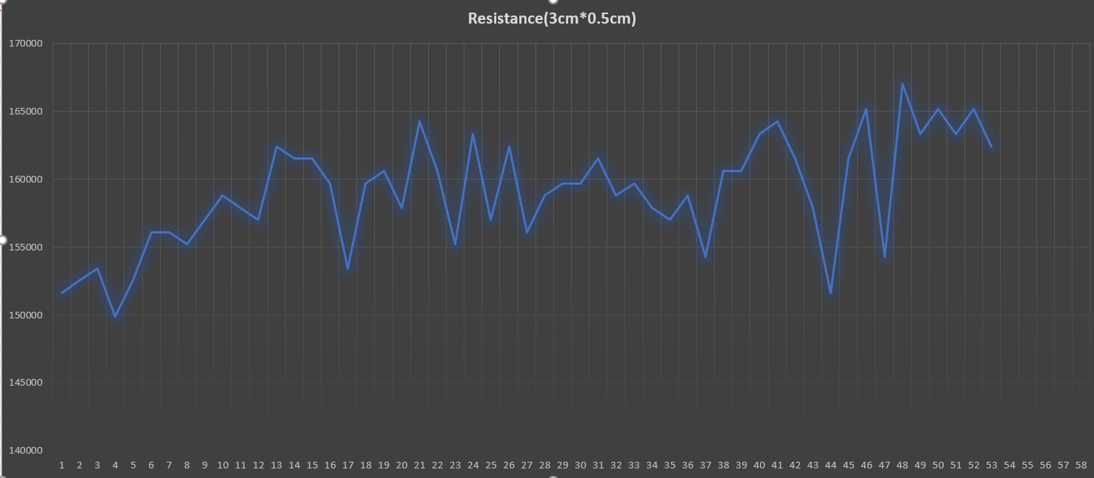

Slide 13
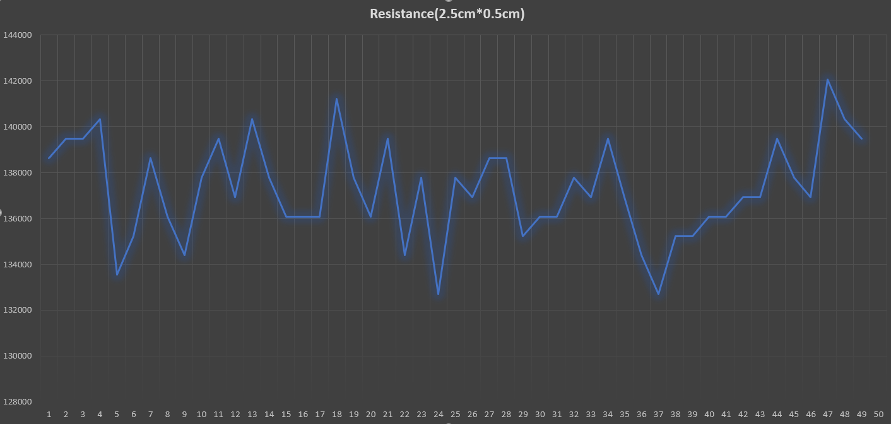
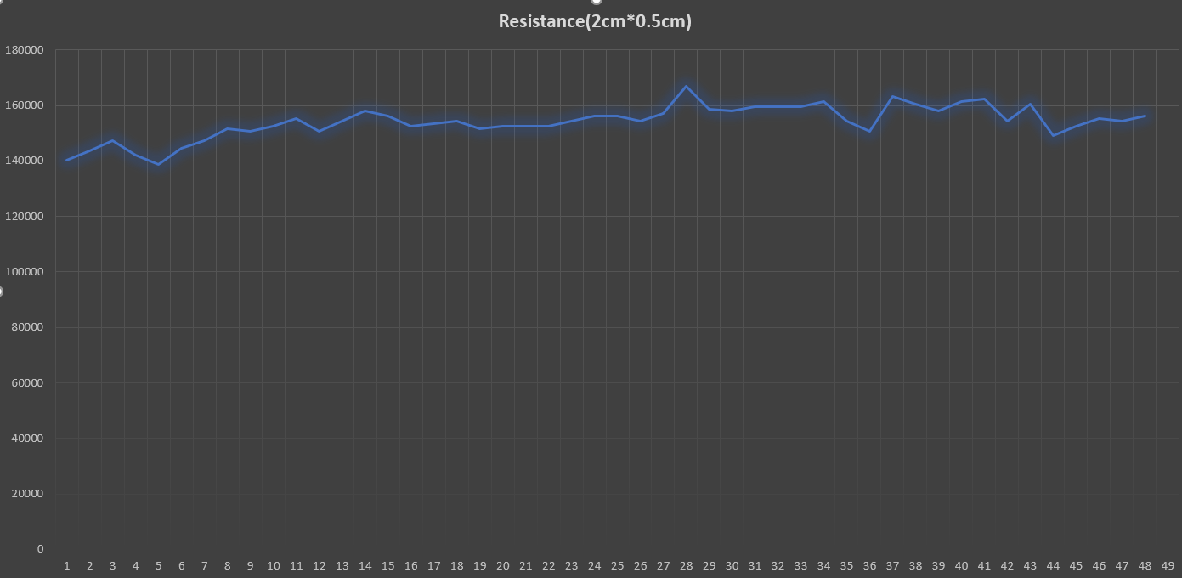

Slide 14
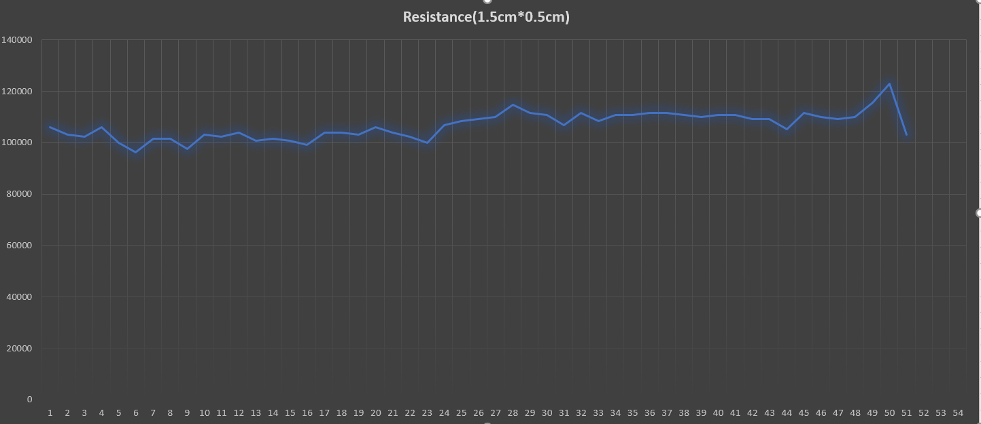
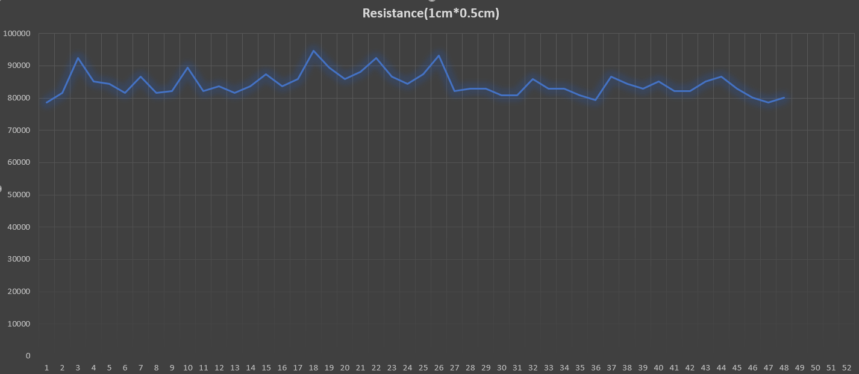

Slide 15
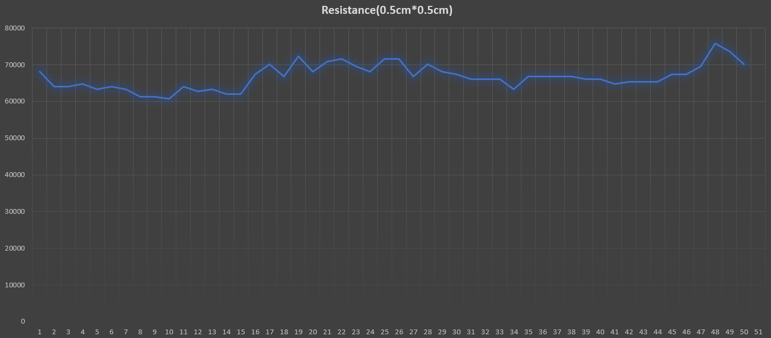
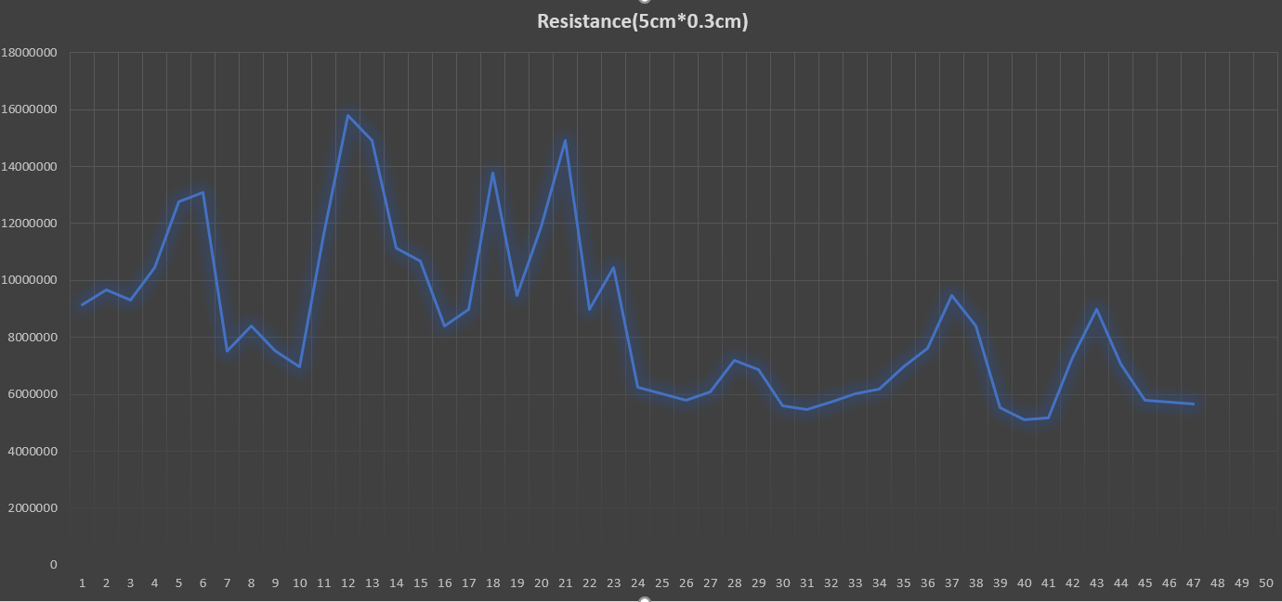

Slide 16
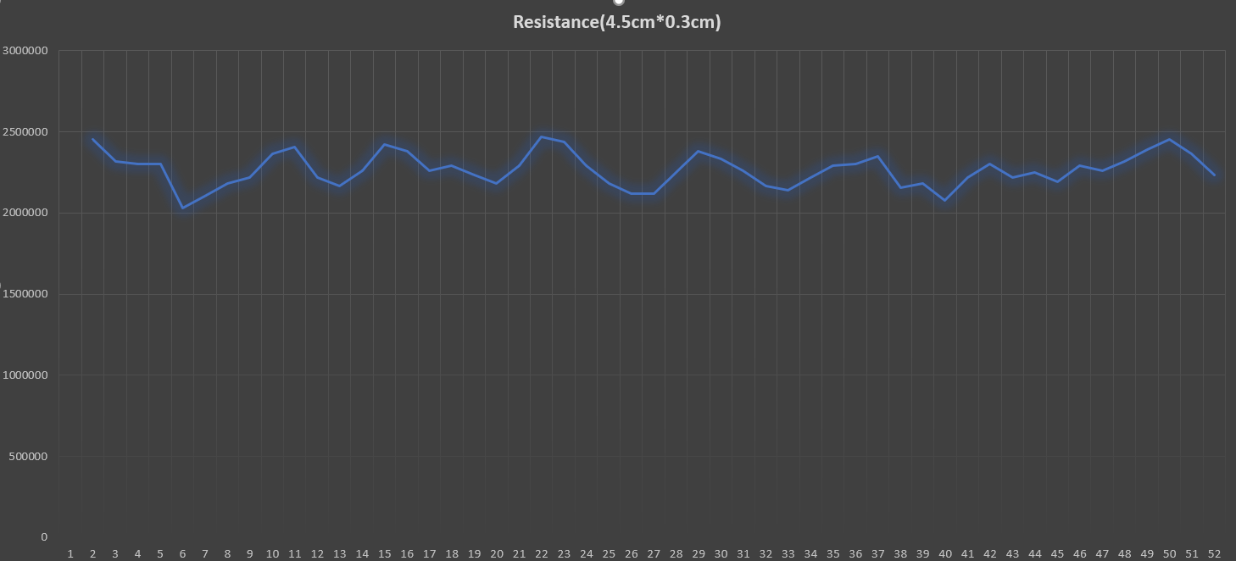
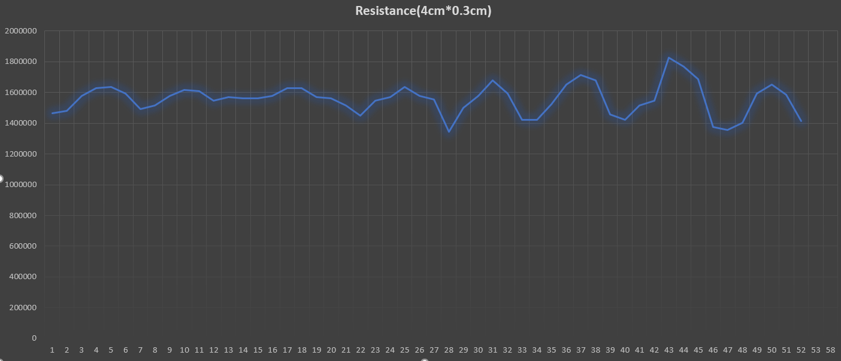

Slide 17
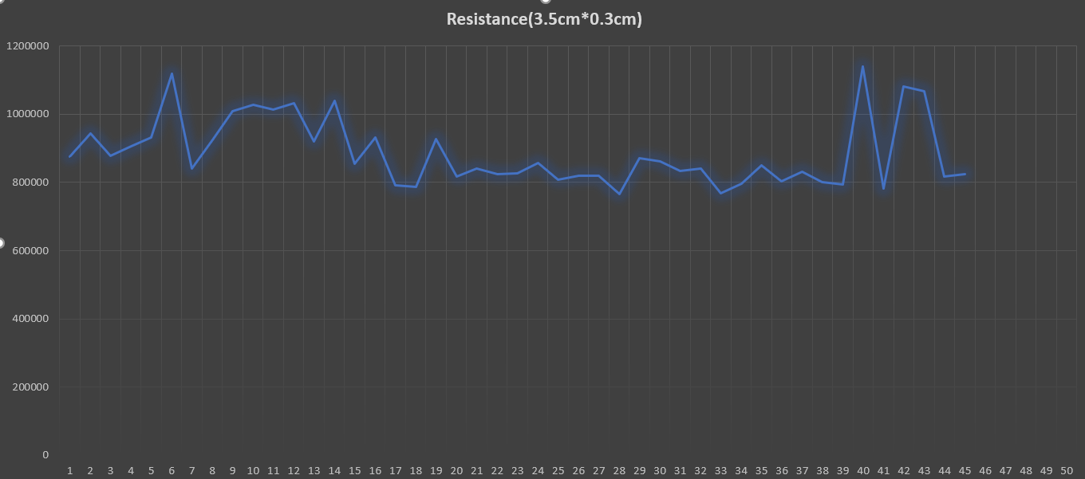
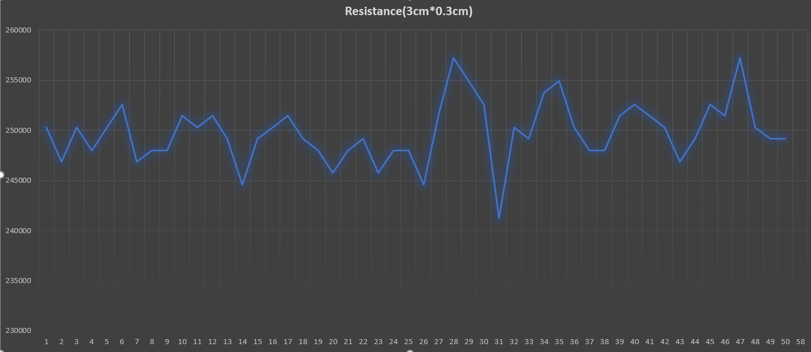

Slide 18
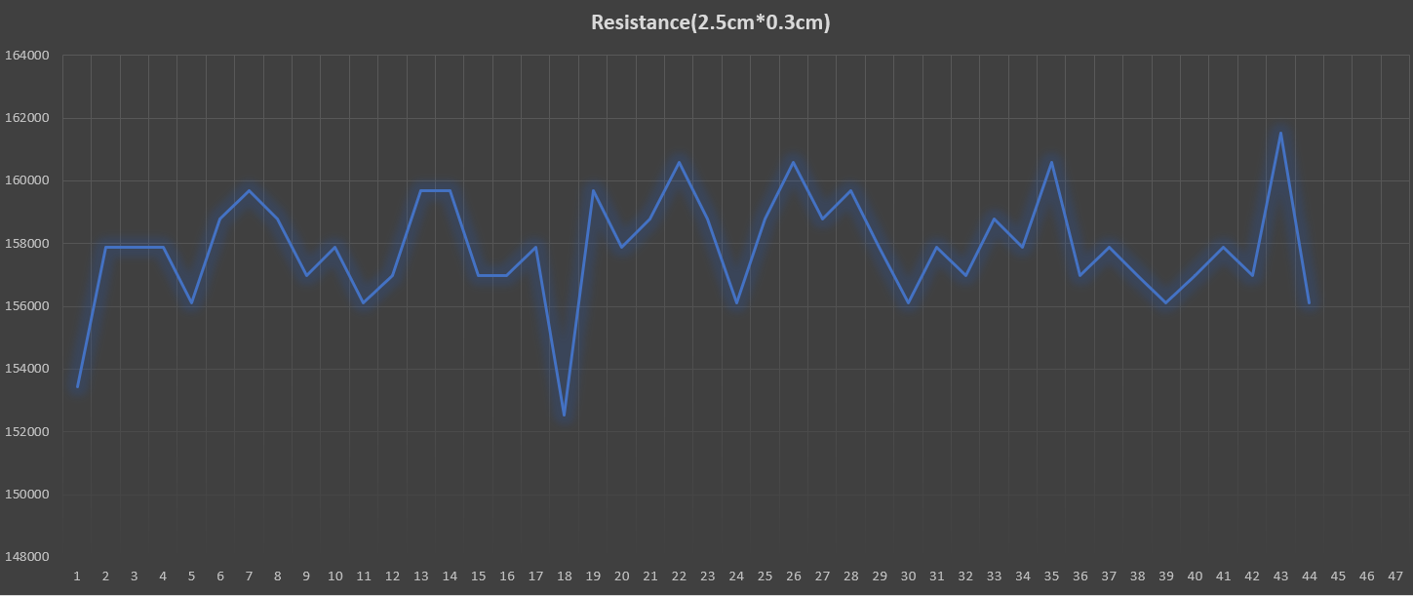
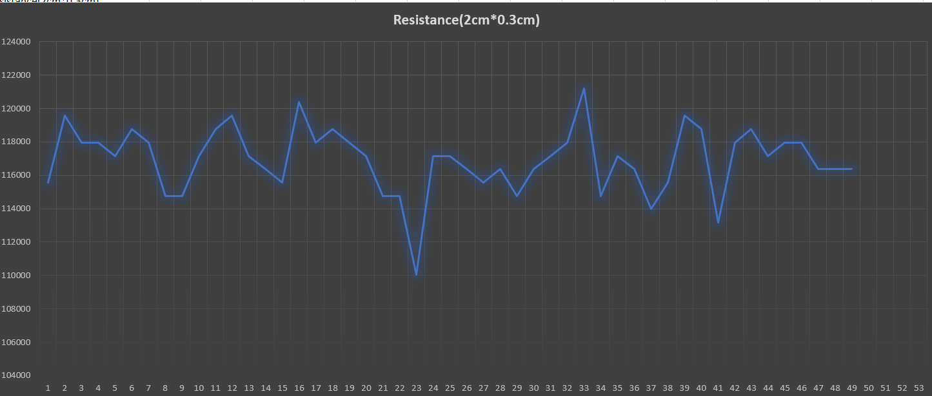

Slide 19
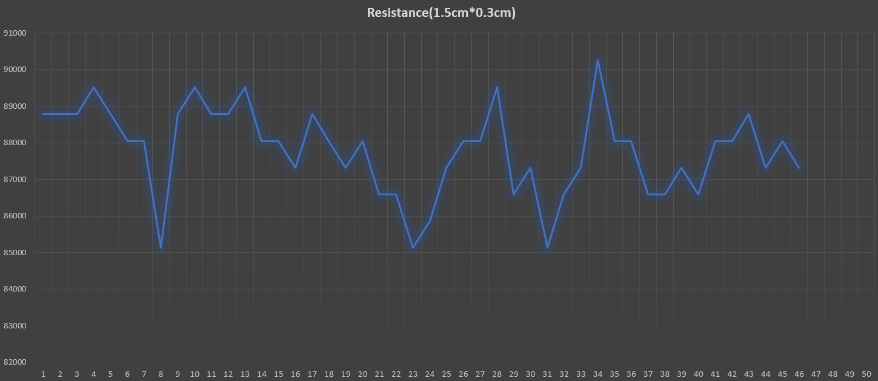
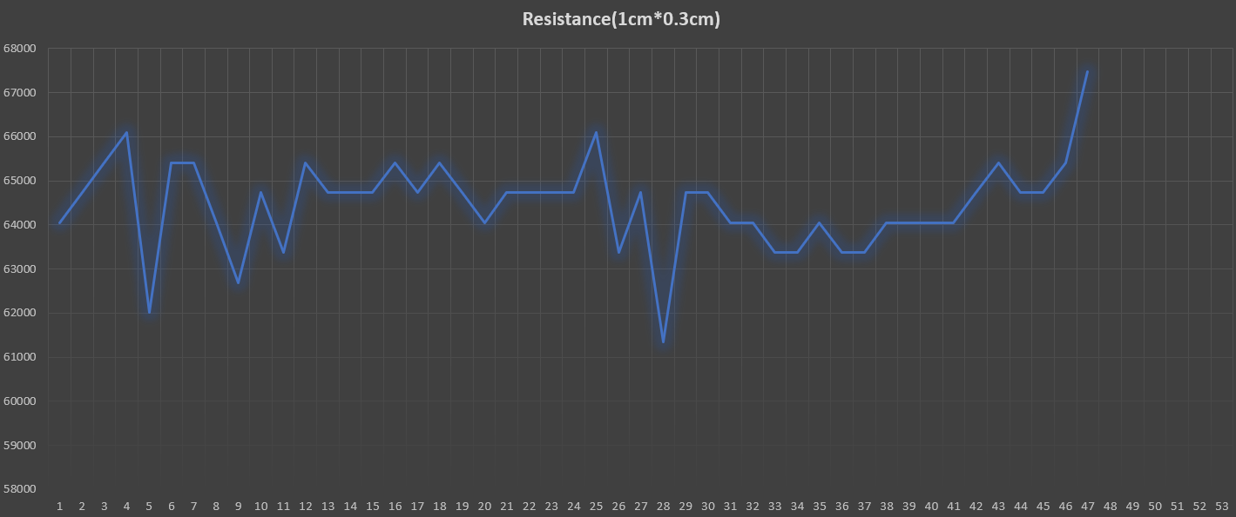

Slide 20
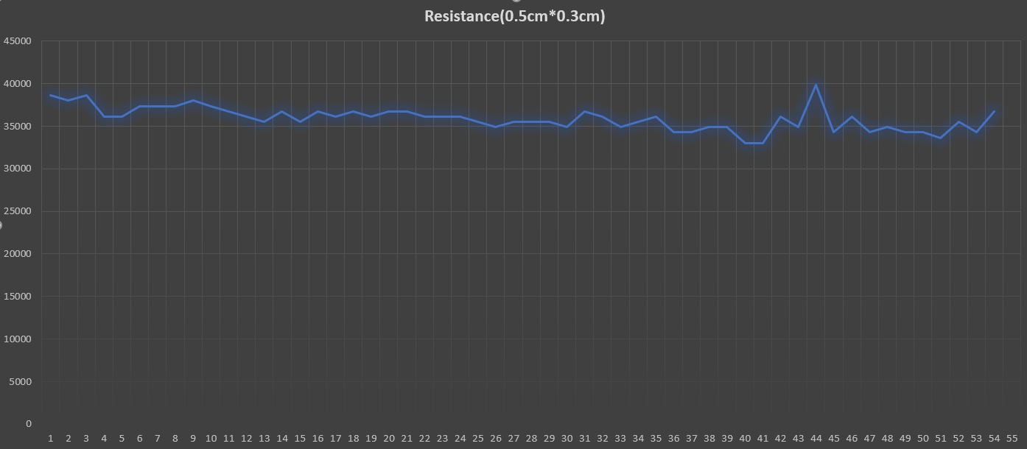

Slide 21
Result:
From the experiments, we can conclude that:
As area occupied by the sensor increases, the variations in resistance also increases.
As the width of the sensor increases with length constant then resistance decreases.
As length of the sensor increases with constant width, the resistance increases.
Sensor’s length must be atleast double the width to avoid variation in resistance.
The suitable dimensions of the sensor:
1cm*0.5cm
1cm*0.3cm

